Slide 1
Xander:
Sexually Transmitted Infections (STIs) Bot
Team A: Abdulaziz A., Ckalib N., Michael W., Nabil M., & Sarang Z.
The Watson Challenge
GMBD – 2020/21

Slide 2
Problem
01
History
02
Our Solution
Solutions
TABLE OF CONTENTS
04
03
Market
05
Conclusion
06
What is the problem?
Why is this a problem?
Xander
How can the problem be addressed?
Who is our market and why?
What are the potential integrations with Xander?

Slide 3
01
Problem
What is the problem?

Slide 4

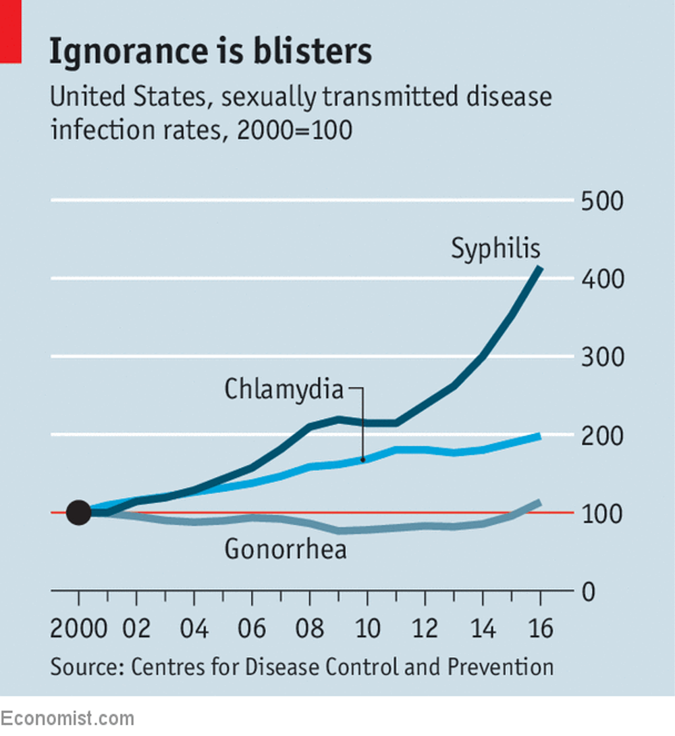
Problem
What is the problem?
Sexually Transmitted Diseases are rising in the United States, England, and Western Europe
In the US, Gonorrhea has surged 46% since 2010 and Chlamydia has doubled since 2000
In England, Syphilis increased by 20% in 2017
Some Western European Countries have witnessed cases of STDs of more than 50%

Slide 5
02
History
Why is this a problem?

Slide 6


History
Why is this a problem?
Limited public funding for STD prevention and monitoring programs
State health departments, clinics, and immediate resources have lower budgets
Young people don’t like to talk about sex because of stigma
Sex is believed to be less risky
There are prescriptions for most STDs
Pregnancy is more of a concern than consequences from not having “safe sex”

Slide 7
03
Possible Solutions
How can the problem be addressed?

Slide 8

Solutions
How can the problem be addressed?
Sex Types
Symptoms
Days, Weeks, etc.
Vaginal, Anal, Oral, Needles, Drugs, and Blood
Discharge, flue, or blisters
Time Since Last Sexual Encounter
Equip a bot with information about STDs to facilitate conversations with users who might be apprehensive about talking to a doctor or users that do not have access to relevant resources

Slide 9
04
Our Solution
Xander

Slide 10


Xander
Why we chose Xander as our chatbot’s name?
Xander means Defender Of The People is of Greek origin.
We want to embody such meaning into our chatbot’s conversations, so the user feels free talking about personal worries, experiences without any judgements nor prejudices.

Slide 11
05
Market
Who is our market and why?

Slide 12




Who is our market and why?
Teenagers
Adults
The Elderly
Account for a large share of new infections due to limited information
Account for a large share of new infections
Chlamydia has more than doubled since 2010, while Gonorrhea has more than tripled

Slide 13
06
Conclusions
What are the potential integrations with Xander?

Slide 14


Potential Integrations with Xander
Embedding AI Process Imaging
For example, the user can upload phots of his/her lips to detect any oral herpes so the chatbot can raise the accuracy of diagnosis
Booking appointments with the nearest hospital
With the support of geo-location capability & Watson Slots feature, the chatbot reserve an appointment with the nearest hospital after getting the initial feedback from the user

Slide 15
THANKS
Team A: Abdulaziz A., Ckalib N., Michael W., Nabil M., & Sarang Z.

Slide 16
RESOURCES
The Economist: Why STDs are soaring in America
Talk Test-Treat: The Good News and Bad News About STDs

